Slide 1


Cryptocurrency Time-series Analysis
Carl Paulus
Ishant Chaudhary
Xiaohui Jiang

Slide 2

CONTENTS
I: Background Information:
Brief Overview of time-series analysis
About Cryptocurrency
Overview of the cryptocurrency data
II: Cryptocurrency Forecasting models
Current Time Series Forecasting Techniques
ARIMA
FB (meta) Prophet
RNN – LSTM
III: Conclusion and Summary CONCLUSION AND SUMMARY
CONCLUSION AND SUMMARY

Slide 3


Background Information
Part 1
Photo by Markus Spiske on Unsplash

Slide 4
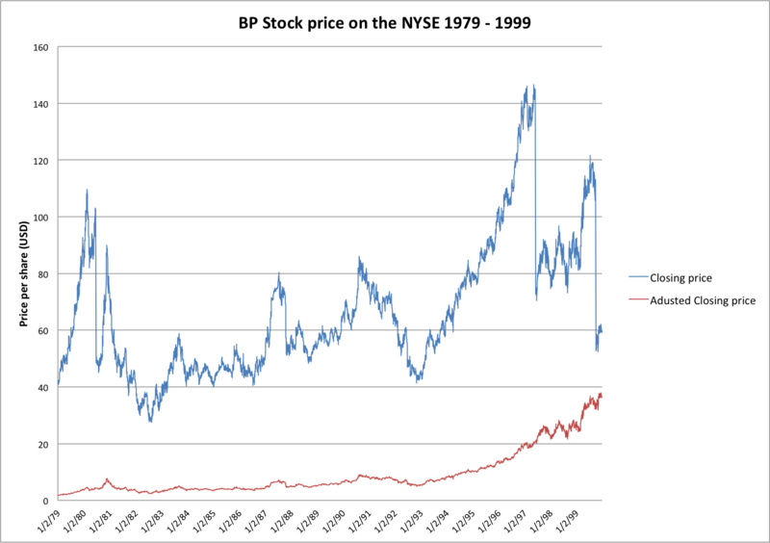
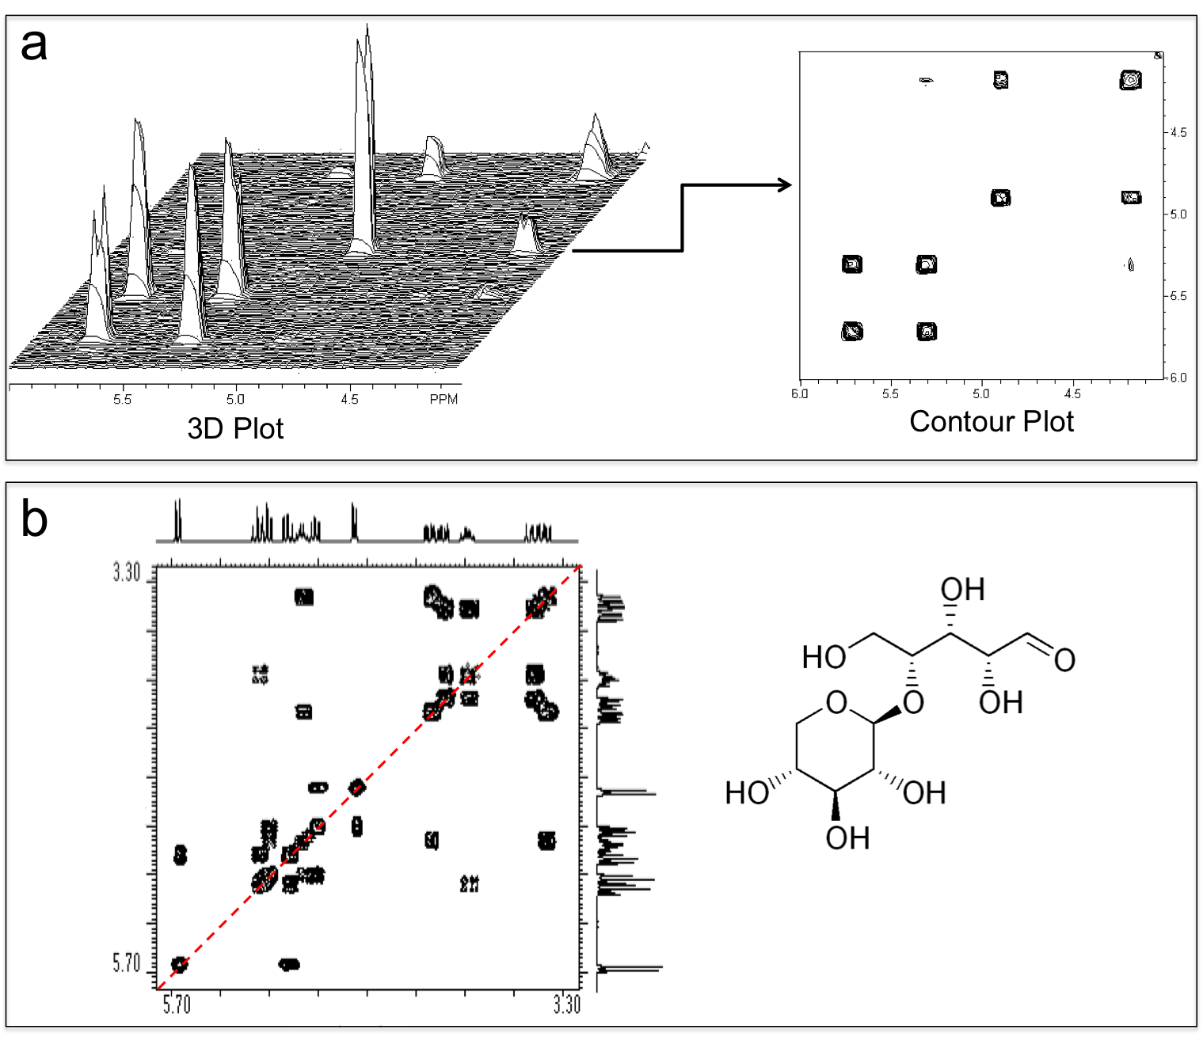
BRIEF OVERVIEW OF
TIME-SERIES ANALYSIS
Data is collected sequentially, one axis monotonically increasing(measurable difference like time or other metrics)
Structure is characterized across data points: seasonality& cycles, autocorrelation(if data is noisy), trends
Stochastic behaviour even as to behaviour regime: stochastic shift to a different regime and change point identification
What is time-series data?
This Photo by Unknown author is licensed under CC BY-SA.
This Photo by Unknown author is licensed under CC BY-SA-NC.

Slide 5





Understanding temporal behaviour of data: seasonality & stationarity (seasonal data like weather, cyclical data like business boom-and-bust cycle)
BRIEF OVERVIEW OF
TIME-SERIES ANALYSIS
Identifying underlying distributions and nature of temporal process producing data(hypothesis about fundamental factors)
Major functions
Estimation of past, present and future values: filtering(like medical sensor measurement error, true value) and forecasting
Classification of time series: normal v.s. abnormal
Anomaly detection of outlier points within time series; which points are the problematic points

Slide 6


Challenges with time-series forecasting
1. Completely automatic forecasting techniques can be brittle and they are often too inflexible to incorporate useful assumptions or heuristics.
2. Forecasting is a specialized data science skill requiring substantial experience, hence demand for high quality forecasts often far outstrips the pace at which the organization can produce them.

Slide 7


What are cryptocurrencies?
About CRYPTOCURRENCY
Cryptocurrency is an internet-based medium of exchange which uses cryptographical functions to conduct financial transactions.
Ms.Rivers (@MsJRivers) | twitter.com
Cryptocurrencies operate by leveraging blockchain technology.
Types: coin and token
Market Cap= current value* its circulating supply
@elonmusk/Twitter

Slide 8
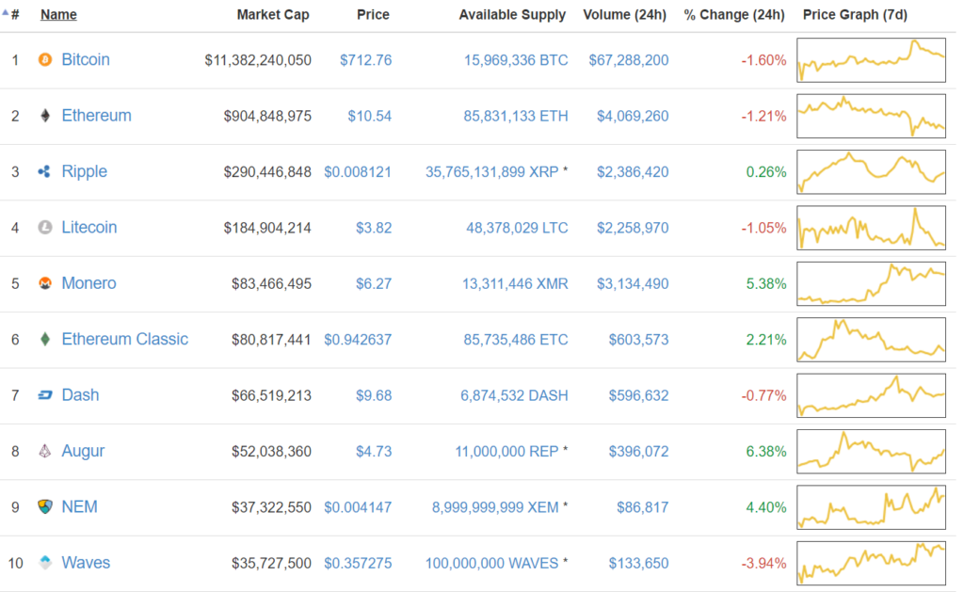
About CRYPTOCURRENCY
Bitcoin

Slide 9
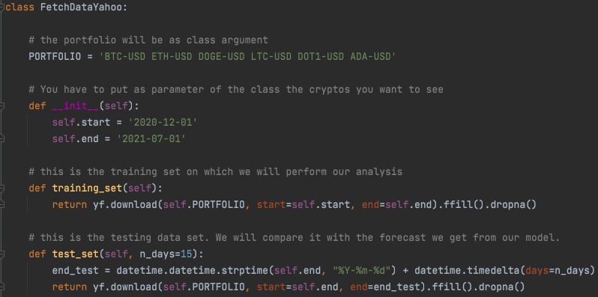
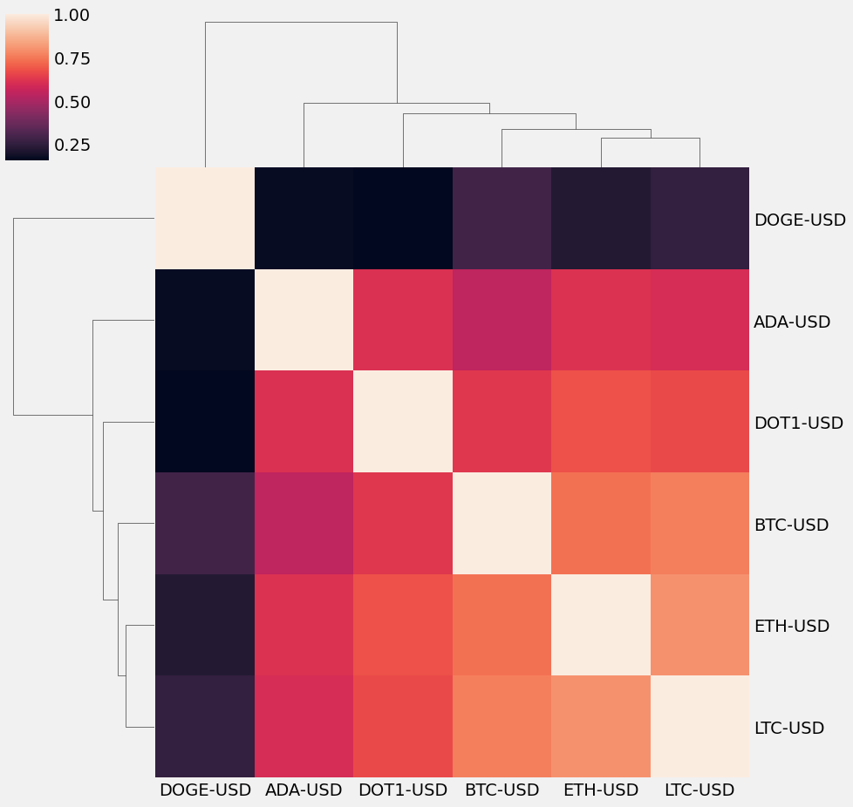
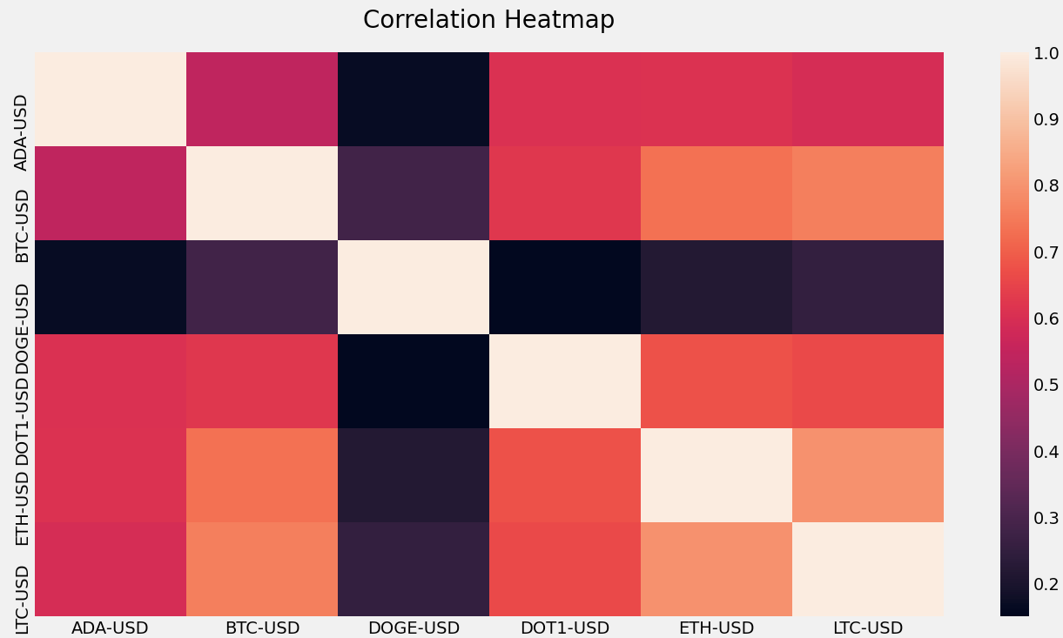
Overview of the crypto data
Fetch Data & Basic Statistics
Annualized returns, annualized volatility
Correlation values between cryptos
Max drawdown
Calmar ratio (ann. returns / max drawdown)
Annualized Sharpe ratio ((Rp-Rf)/std)
Heatmap and Clustermap (seaborn package)
Notes:
Max drawdown: The maximum loss you could have had.
Calmar ratio : The higher the Calmar ratio, the better it performed on a risk-adjusted basis
Sharpe ratio: The ratio is the average return earned in excess of the risk-free rate per unit of volatility. (get the return gotten from risk exposure for each volatility unit or total volatility i.e. risk
Heatmap : get the correlation between cryptos
Clustermap : cluster the cryptos that are correlated between each other. So here it’s not really meangful on that point but at least it ranks the cryptos from the least correlated to the most.

Slide 10
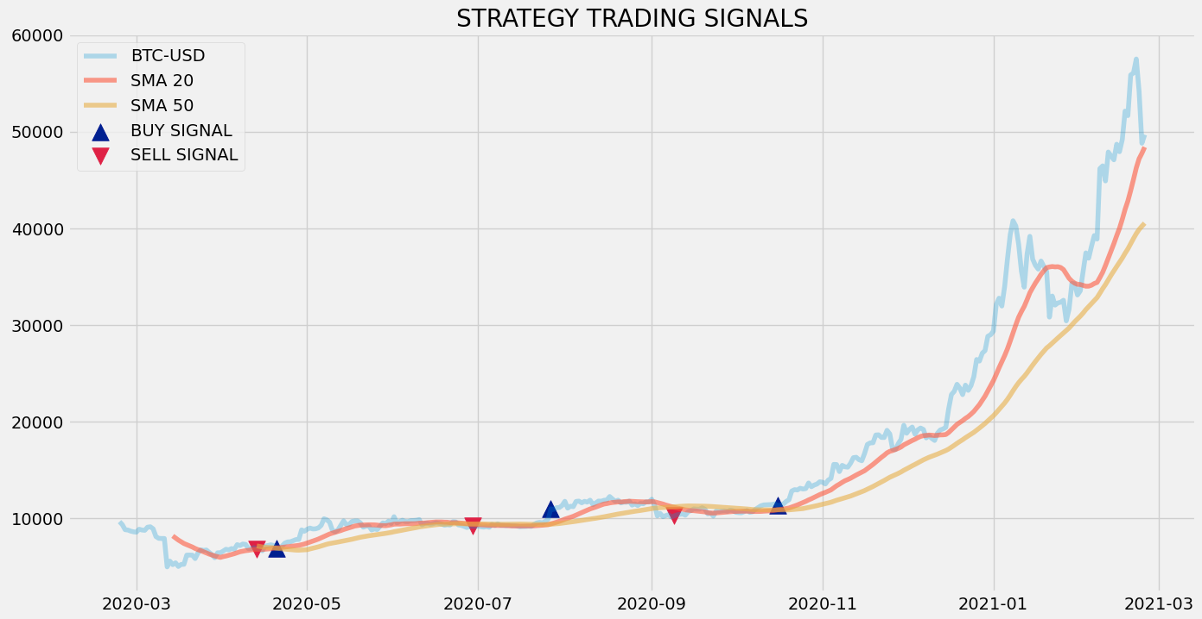
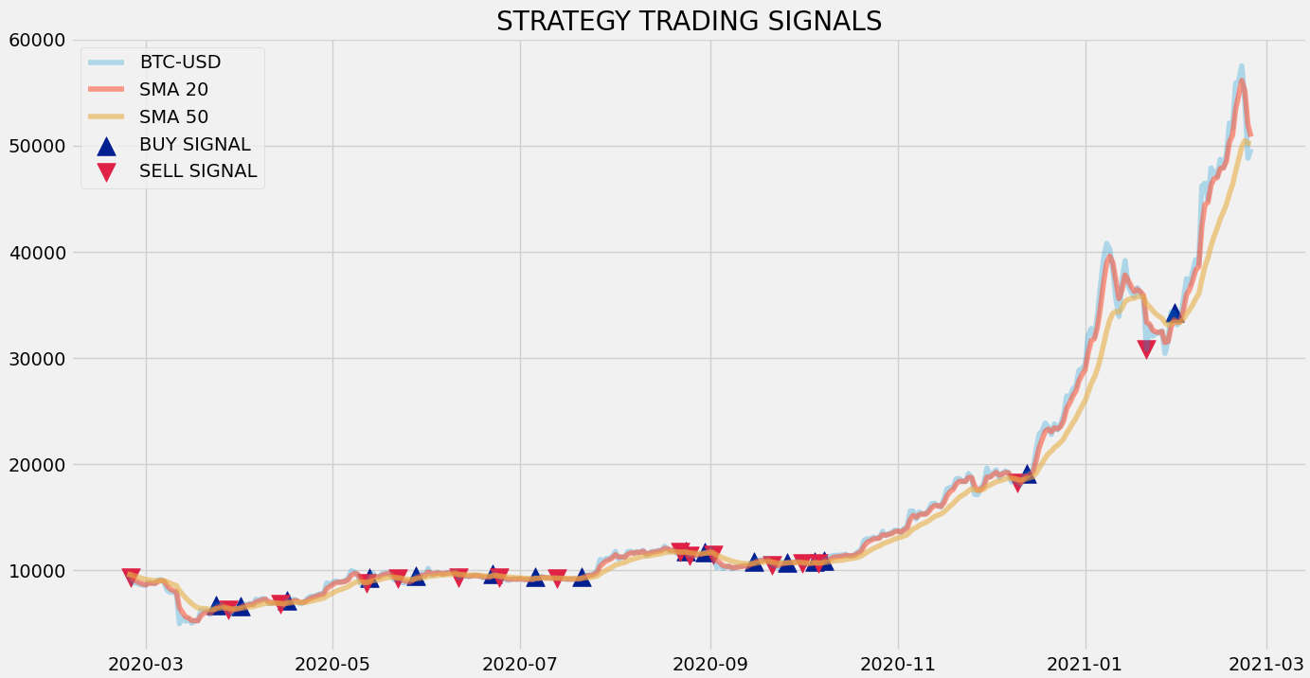
Overview of the crypto data
Moving Averages strategies
Simple Moving Averages
Exponential Moving Averages
Profits from the strategy by investing $100K between 25/02/2020 and 25/02/2021 : $371,384.42
Profits from the strategy by investing $100K between 25/02/2020 and 25/02/2021 : $357,772.56
Notes:
Avrage calculated every 3 days and every 14 days.
# IF SMA(SHORT PERIOD) > SMA(LONG PERIOD) => BUY # IF SMA(LONG PERIOD) > SMA(SHORT PERIOD) => SELL
Then plot the trading signals
And do backtest that calculates the returns
Difference with EMA:
Exponential moving window – uses an exponential of 3 and 14
Result: “ line and 14 line are gonna cross more often = more signals = more trades = costlier strategy for a trader

Slide 11
Cryptocurrency Forecasting models
Part 2
Photo by Markus Spiske on Unsplash

Slide 12
CURRENT TIME-SERIES FORECASTING APPROACHES
Some of the most common methods used for Time Series Forecasting:
•Naïve, SNaïve
•Seasonal decomposition (+ any model)
•Exponential smoothing
•ARIMA, SARIMA
•GARCH
•Dynamic linear models
•TBATS
•Prophet
•NNETAR: Neural NETwork AutoRegression
•LSTM: Long-Short Term Memories (Deep Learning)
Notes:
We used 3 of those

Slide 13

Cryptocurrency Forecasting models
ARIMA
Facebook's (Meta) Prophet
LSTM Deep Learning

Slide 14
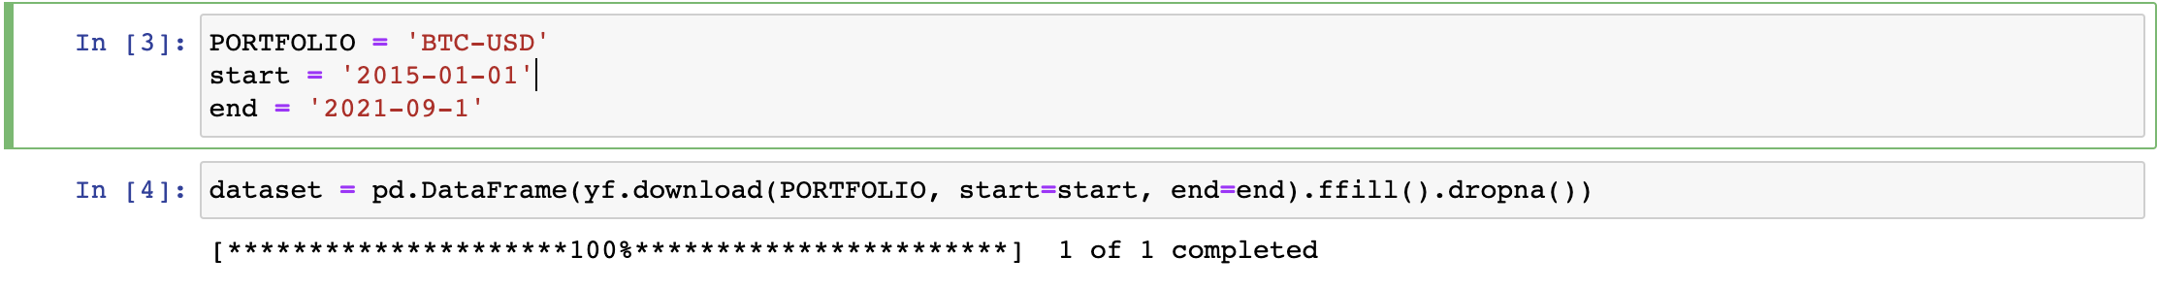
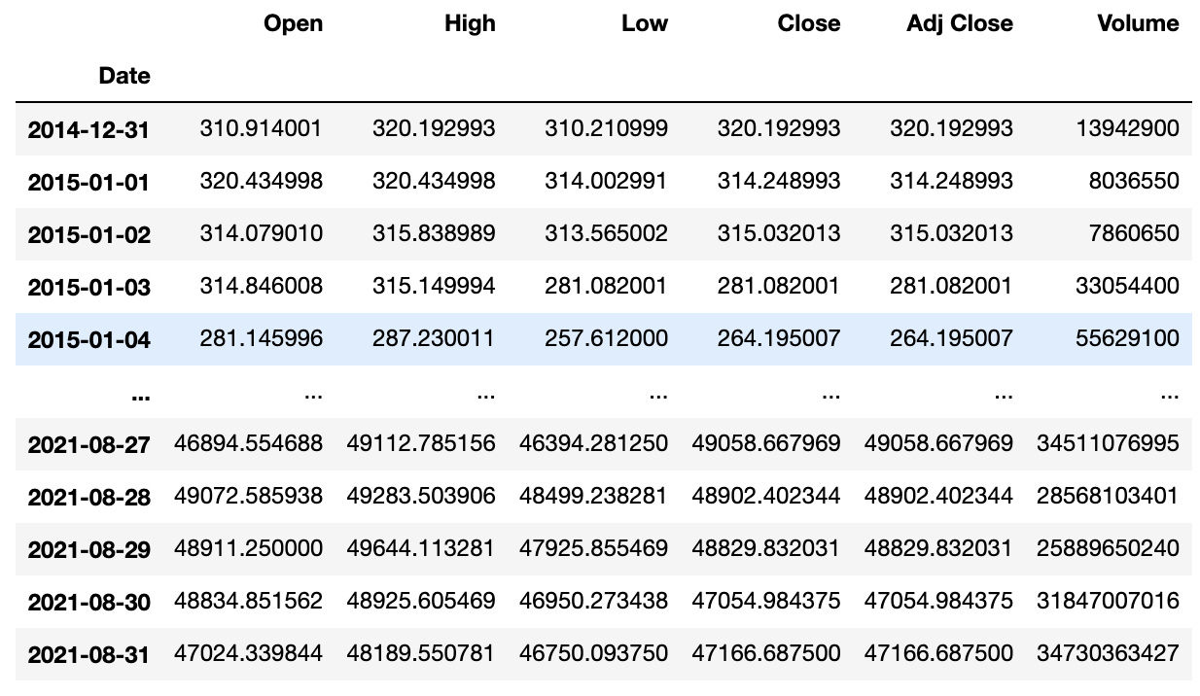
Data
We used the yfinance (yahoo finance) package in python to fetch BTC-USD daily data.

Slide 15

ARIMA model
Autoregressive Integrated Moving Average – often used in econometrics for time series analysis
A “stochastic” modelling approach that can be easy to calculate
Mix of auto regressive model and moving average model
Stationarity test : find a unit root
Null Hypothesis (H0), Alternative Hypothesis (H1)
p value > 0.05: Accepts the Null Hypothesis (H0), the data has a unit root and is stationary
p value < = 0.05: Rejects the Null Hypothesis (H0), the data is non-stationary
Log transforming the series : unskew highly skewed data to help for the forecasting process
Remove trend and seasonality with differencing
The current value is subtracted with the previous values – the mean is stabilized – chances of stationarity of time series are increased
If stationary
If still stationary
Notes:
1. Null Hypothesis (H0): Null hypothesis of the test is that the time series can be represented by a unit root that is not stationary.
2. Alternative Hypothesis (H1): Alternative Hypothesis of the test is that the time series is stationary.

Slide 16
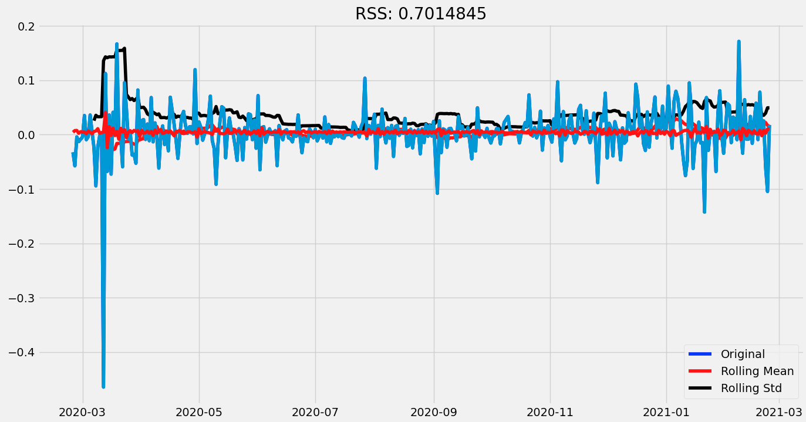
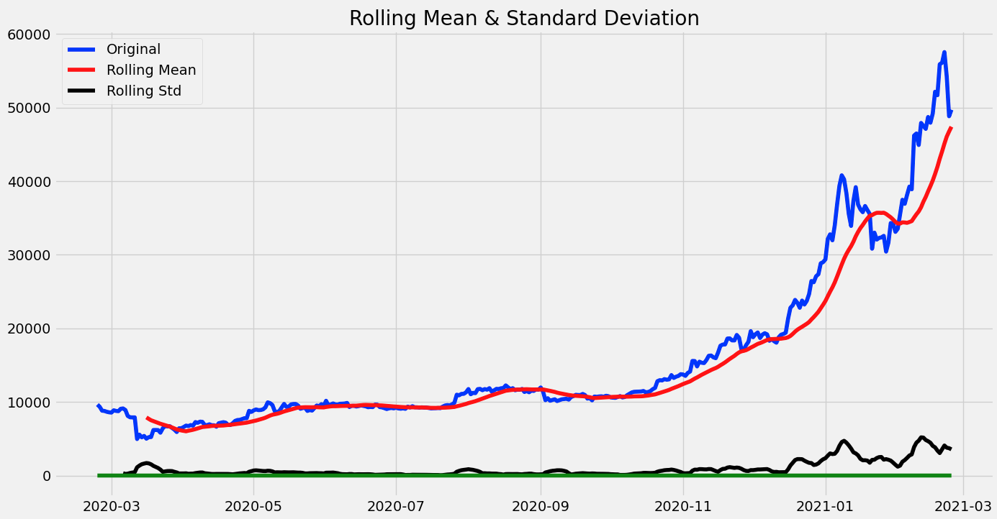
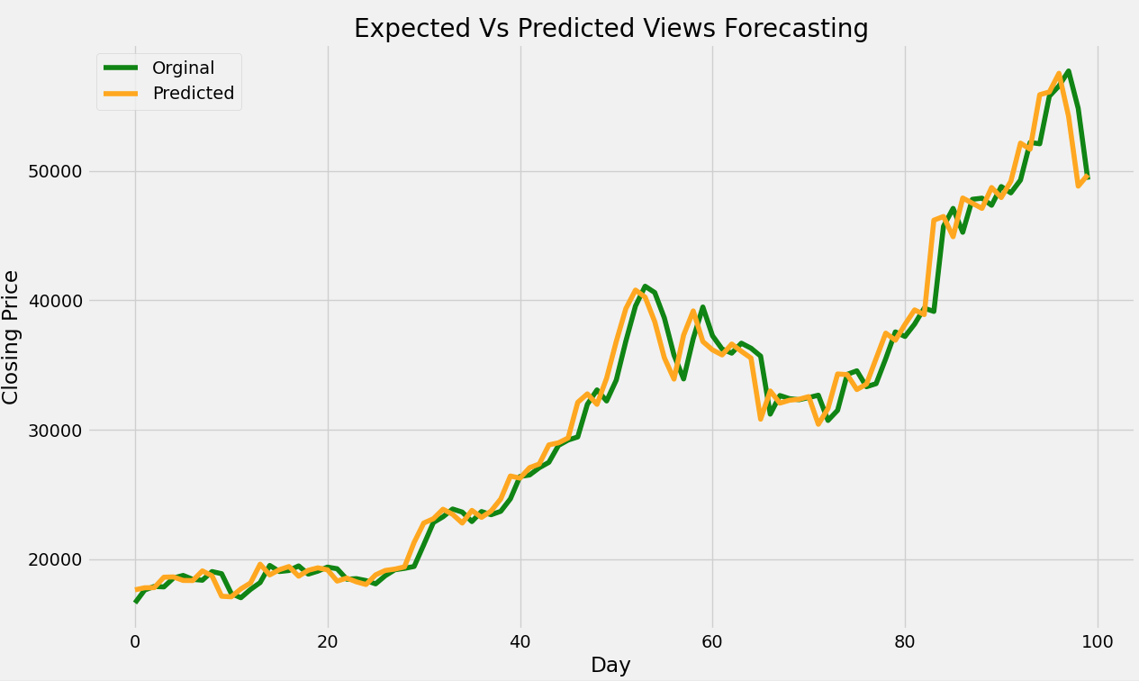
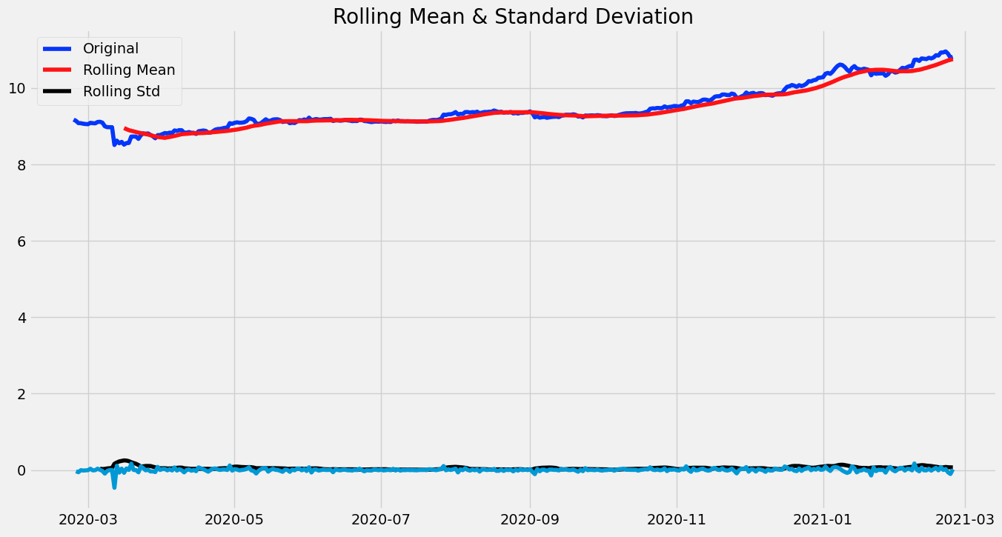
Stationarity test with differencing to remove trends and seasonality
ARIMA results
Stationarity test on prices
Stationarity test on log transformed prices

Slide 17
ARIMA Advantages / disadvantages
Advantages
Disadvantages
Great for short term forecasts
Preference should be given to the rolling origin evaluation
No automatic updating feature as new data become available
Large data requirements
Requires a stationary data series
The forecast is determined only by the past behaviour of the variable

Slide 18


Facebook PROPHET (Meta Open Source)
Prophet is a procedure for forecasting time series data based on an additive model where non-linear trends are fit with yearly, weekly, and daily seasonality, plus holiday effects.
It works best with time series that have strong seasonal effects and several seasons of historical data.
Prophet is robust to missing data and shifts in the trend, and typically handles outliers well.
We used prophet for predicting a highly volatile cryptocurrency which lack seasonality and we were not able to receive satisfactory results.

Slide 19
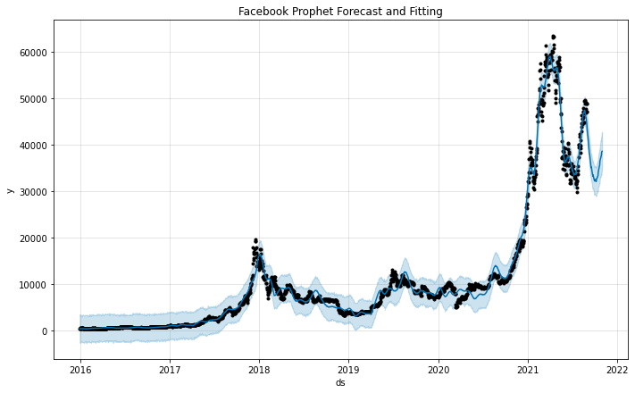
FB Prophet
Model was trained on the data from '2016-01-01' to '2021-08-31'
Predictions were made for '2021-09-01' to '2021-11-01'
Blue line = Forecasted values / Black dots = Observed (actual) values / Blue-shaded region = Uncertainty intervals#

Slide 20
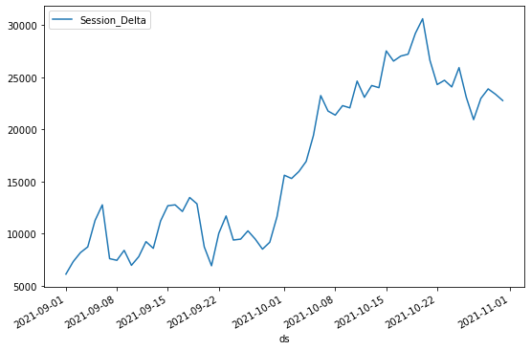
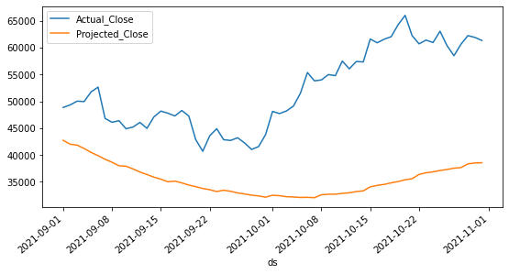

Prophet Results
On an average the predictions are off by 16.5 K USD.
Can't get rich with this model

Slide 21
Advantages
FB Prophet
Disadvantages
Easy to implement and highly tunable
Open Source
Quick results
Easy visualizations
Deals with seasonality and has parameters for holiday seasonality
Scales well in both R and Python
Requires data to be specified in a fixed format
Does not perform out of the box for highly volatile data
Domain knowledge is needed to tune the model

Slide 22
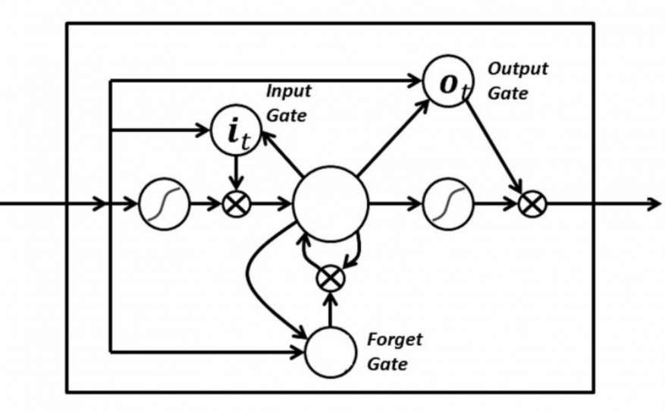
RNN-LSTM Approach
Long short-term memory networks are an extension of recurrent neural networks, which basically extend the memory.
Model was trained on the data from '2015-01-01' to '2021-03-31'
Predictions were made for '2021-04-01' to '2021-08-31'

Slide 23
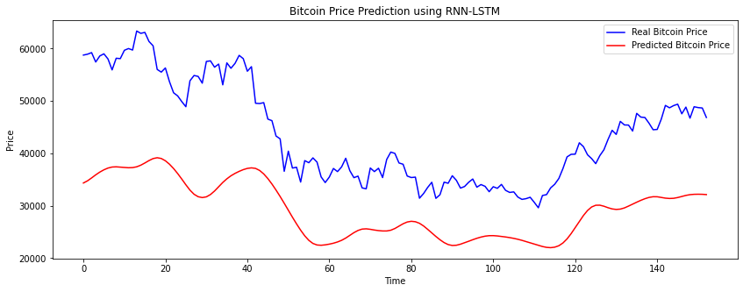
Results - LSTM
The model performed better and could grasp the trend.
Needs more parameter tuning to get better results.
Maybe, you can invest using the trends suggested and make money!

Slide 24
LSTM:
Advantages:
Disadvantages:
Produces good results​
Performs well with seasonality and trends.
Requires a lot of data
Complex to implement
Have a lot of parameters to be tuned
Hyperparameter tuning needs a lot of experience
Computationally expensive

Slide 25
Conclusion and Summary
The purpose of the project was to create predictions and be able to chart out investment advice and strategies.
Prophet performed poorly on the highly volatile Bitcoin data
LSTM worked better but still requires a lot of tuning and research to create a practical model.
Cryptocurrency portfolio construction: choose uncorrelated assets (see heatmaps and clustermaps) to minimize risk as cryptos are already very volatile (i.e. risky)

Slide 26
Next Steps
Focusing on parameter tuning for LSTM and improve the accuracy.
In the prophet model for BTC prediction, the results can be improved if we use the news events from around the world about the ban and acceptance of BTC as spike points(holiday effects).
It would be interesting to use the Dogecoin data for predictions using FB prophet and add the tweets from big players like Elon Musk as the spike points(holiday effects). Prophet might perform better with that data.

Slide 27
Q&A
Photo by Markus Spiske on Unsplash

